Slide 1


Doctor Appointment System

Slide 2

Oriental Institute Of Science And Technology
Submitted by -
Submitted to-
Dr. Farah Haneef
Somya Shivhare(104)
Sachin Yadav(88)

Slide 3
Table of contents
01
Overview
Feasibility study
Objective
Diagrams
Existing system
10
Testing
Proposed system
Future enhancement
Scope
Conclusion
07
Modules
08
02
09
03
05
11
06
12

Slide 4

01
Global Hospital
Stay Safe, Stay Healthy. Caring For You

Slide 5

Overview
DAS was introduced to solve the complications coming from managing all the paper works of every patient associated with the various departments of hospitalization with confidentiality. DAS provides the ability to manage all the paperwork in one place, reducing the work of staff in arranging and analyzing the paperwork of the patients.

Slide 6

Objective
1) To computerize all details regarding patient details & hospital details
2) The main objective of this project is scheduling the appointment of patient with doctors to make it convenient for both.
. 3) Provide the 24*7 accessible website with user – friendly GUI(Graphical User Interface) to manage the records
4) The information of the patients should be kept up to date and there record should be kept in the system for hospital purposes.
.

Slide 7

Existing system
Hospitals currently use a manual system for the management and maintenance of critical information.
The current system requires numerous paper forms, with data stores spread throughout the Doctor Appointment infrastructure.
Multiple copies of the same information exist in the hospital and may lead to inconsistencies in data in various data stores

Slide 8

Proposed System
The DAS is designed for any hospital to replace their existing paper based system.
The new system is to control the following info:
patient information
doctor availability
Appointment system
Patient prescription and patient can be seen by online.
History and patient can be give appointment by online

Slide 9

Scope
This system is very simple and user friendly. Some of its key features are-
There is collection of hospital information
Smart way of appointment
In patient & out patient report
Mange patient & doctor account
Create prescription for patient
Treatment report
Minimal time consumption

Slide 10


MODULES
The entire project mainly consists of
3 modules, which are
Admin module(receptionist)
User module(patient)
Doctor module

Slide 11
Admin Module
Receptionist
Doctor visit schedule
Doctor Appointment Scheduling
Enquiry of Patient
Find History of Patient Enquired.
New Patient Registration

Slide 12

Doctor & Patient Module
Doctor :
A doctor can be managed following this:
Prescribed
Appointment approve
Add medical report
Hospital management mainly focus for patient's facility Patients facility given below:
Access in own profile
View prescription online
Get appointment online
View diagnosis report
Patient :

Slide 13
Advantage of Computerized DAS
Immediate access of data
User Friendly interface
Time saving
Data can be easily insert/update/delete
Saving paper work
Give facility of different types of enquiry
Data are easily approachable

Slide 14
Feasibility study
Economical feasibility - the system being developed is economic with the hospital point of view . It is cost effective as it eliminates paperwork completely. The result obtained contains minimum errors and highly accurate as the details required.
Technical feasibility – the technical requirement for the system is economic and its does not use any other additional hardware & software.
Behavioural feasibility – the system working is quit easy to use and learn due to its simple and attractive interface.

Slide 15
02
Designs

Slide 16
Use case diagram
Visit site
Login
My appointment
register
Add Prescription
Search doctor
My details
Logout
Doctors
Take appointment
Manage patients
View appointment
Manage appointments
Patients
Change password
Prescription list
Doctor list
feedback
View feedback
Receptionist

Slide 17
DFD (Data flow diagram)
Hospital management
Patients management
Doctor management
Doctor Appointment management
Posts management
System user management
Appointment management
Zero level DFD – Doctor Appointment system

Slide 18
DFD (Data flow diagram)
Patients management
Generate hospital report
Hospital management
Generate
patient report
Doctor Appointment system
Doctor management
Generate posts
Appointment management
Check user login details
System user management
Generate appointment report
report management
Generate user report
First level DFD – Doctor Appointment system

Slide 19
DFD (Data flow diagram)
Login to system
Check roles of system
Admin
Manage hospital details
Manage patient details
Send Email to user
Check posts
Manage modules
Manage doctor details
Manage services details
Manage appointment details
Manage system admins
Manage user
Manage reports
Second level DFD - Doctor Appointment system

Slide 20
Entity-Relationship Diagram
department
Gender
Age
Name
E-mail
phone
D_id
Doctor
Treatment
Name
patient
phone
E-mail
Gender
P_id
My appointment
Gender
Age
E-mail
receptionist
Name
R_id
phone

Slide 21
Testing Used
Unit Testing – Every module was tested independently before adding it to the main code.
Integration Testing- The Entire Program was tested after integrating a new module or function.
Black Box Testing – We tested the entire program with a wide variety of inputs to check its response.

Slide 22
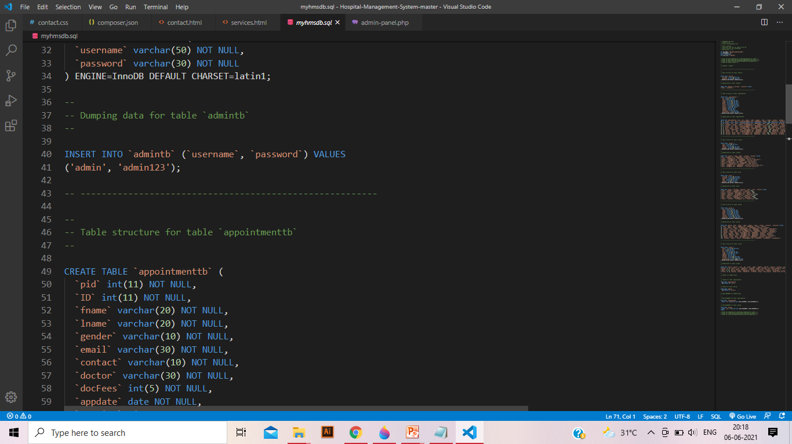
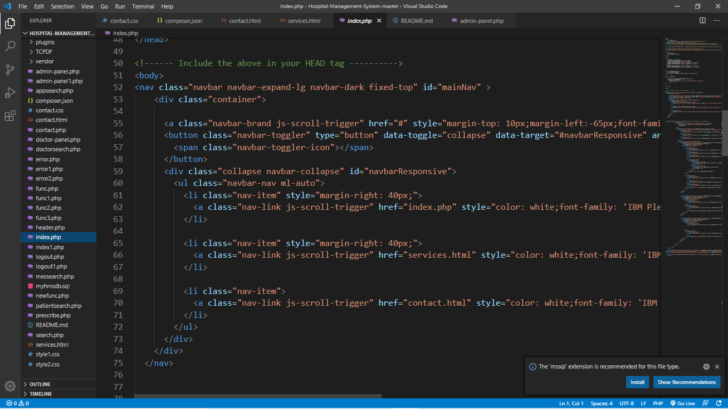
Coding
Step1: Create MySQL Database Table
Step2: Manage User Login

Slide 23
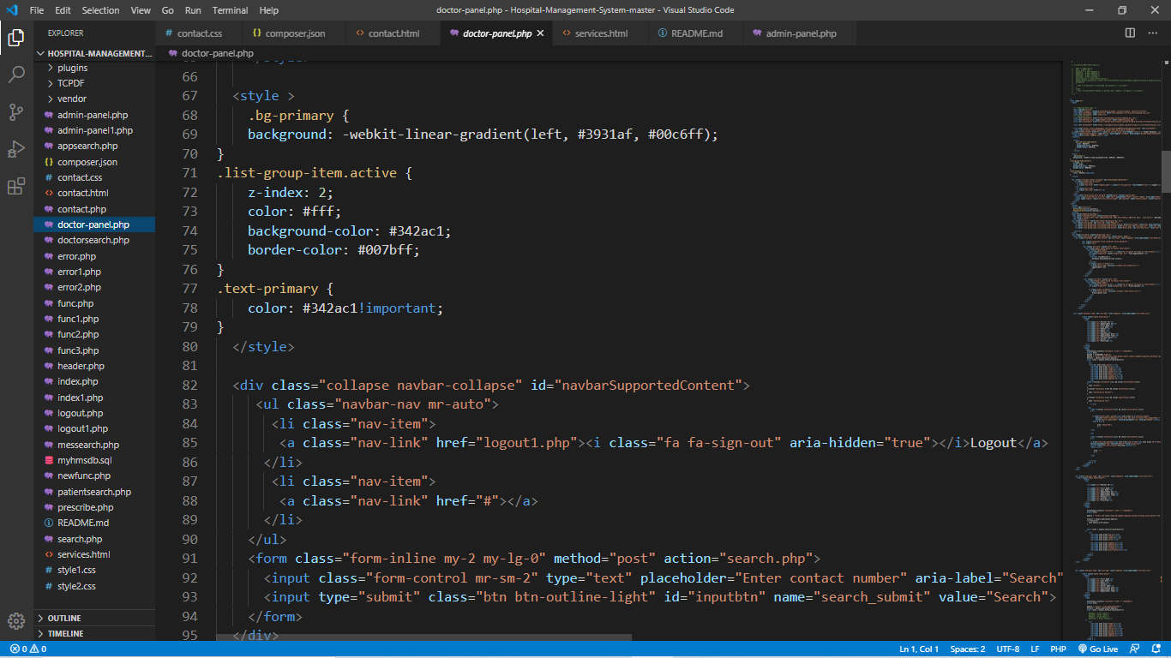
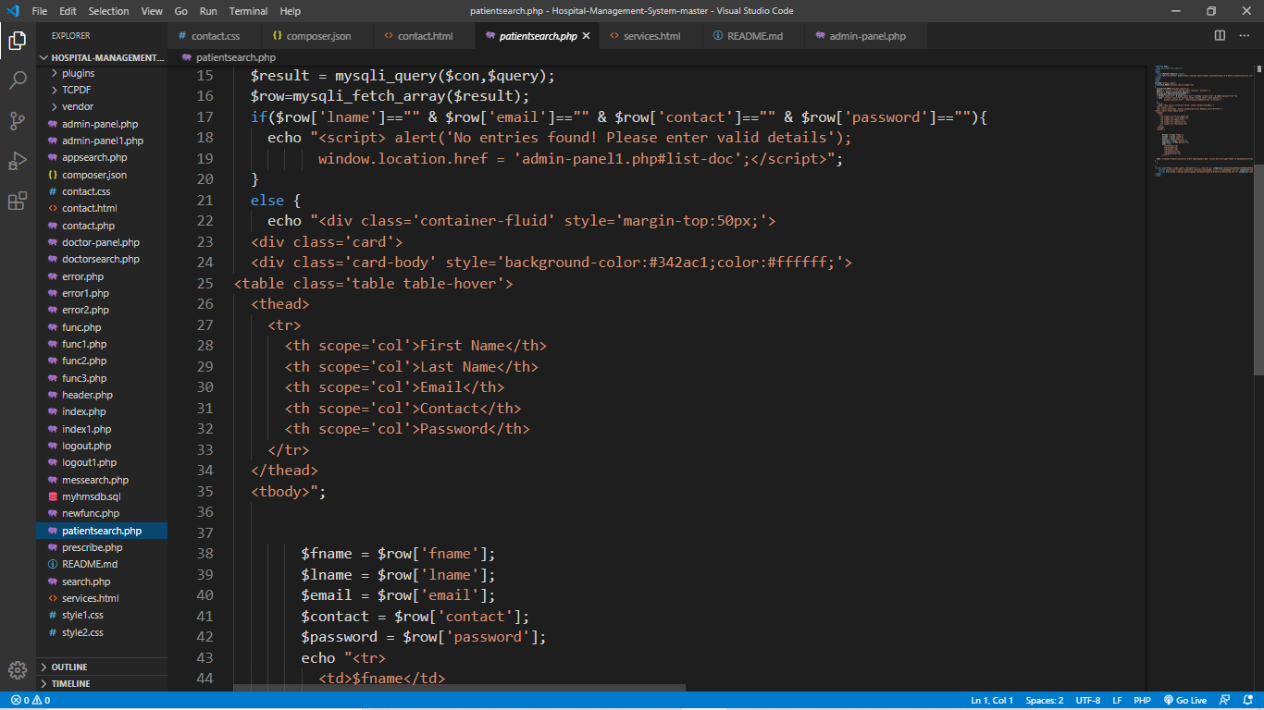
Step3 : Manage doctor
Step4 : Manage patient
Step5 : Manage appointment

Slide 24
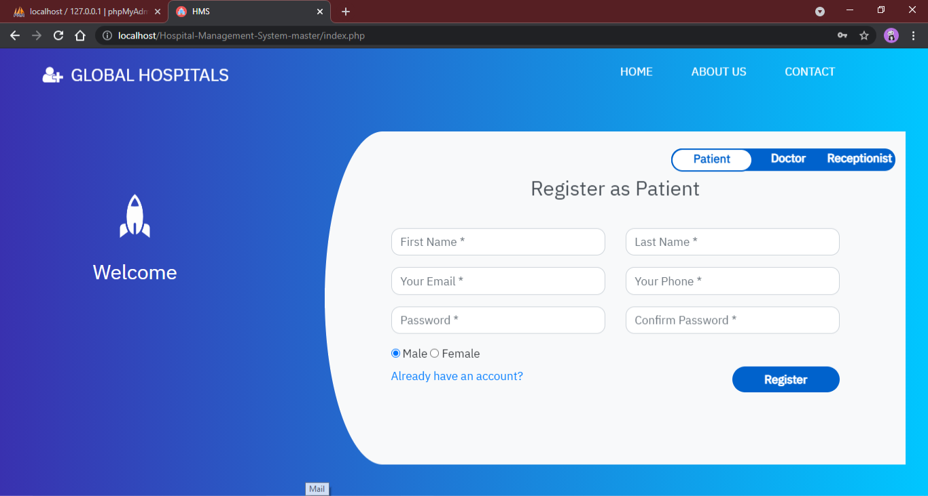
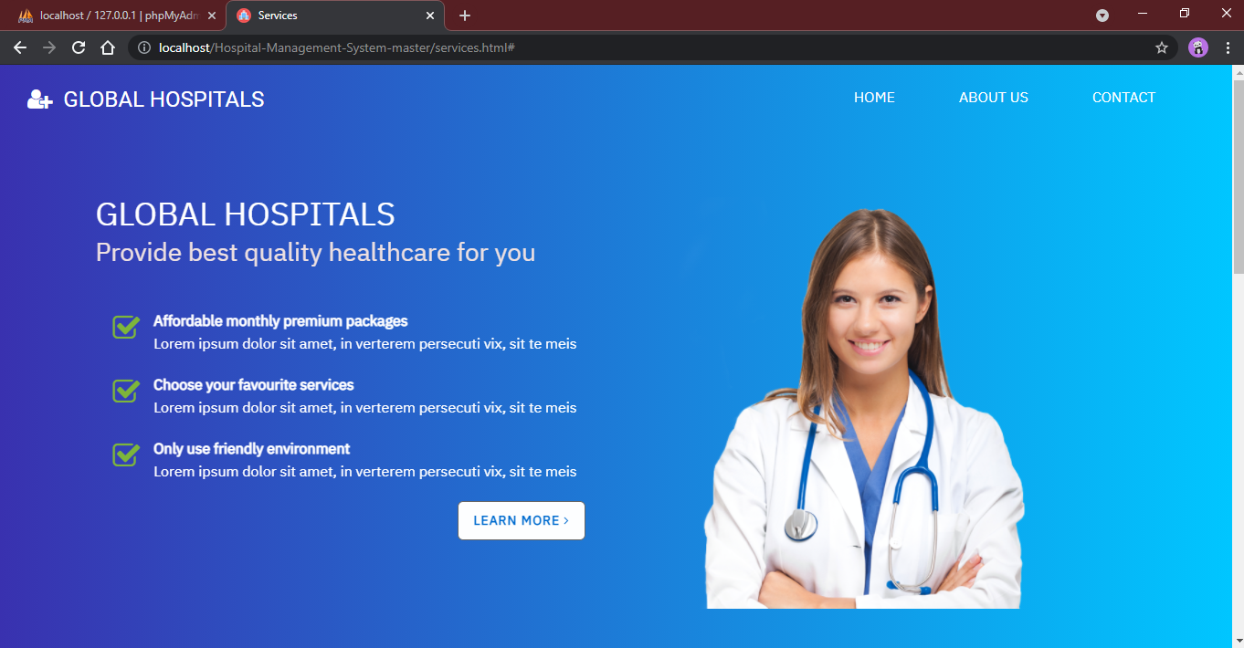
Snapshots
Home page
About page

Slide 25
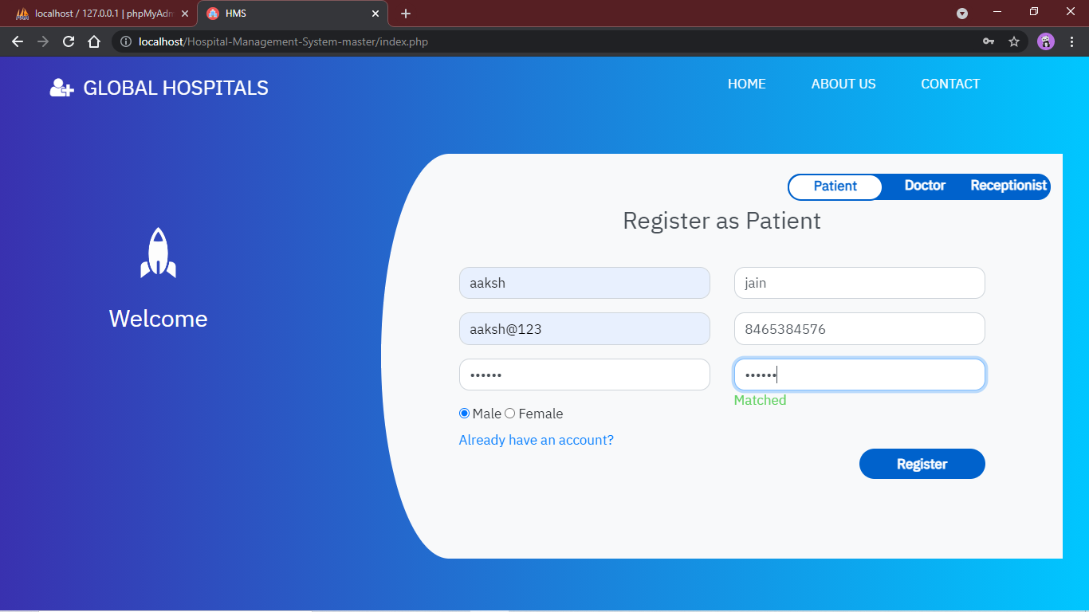
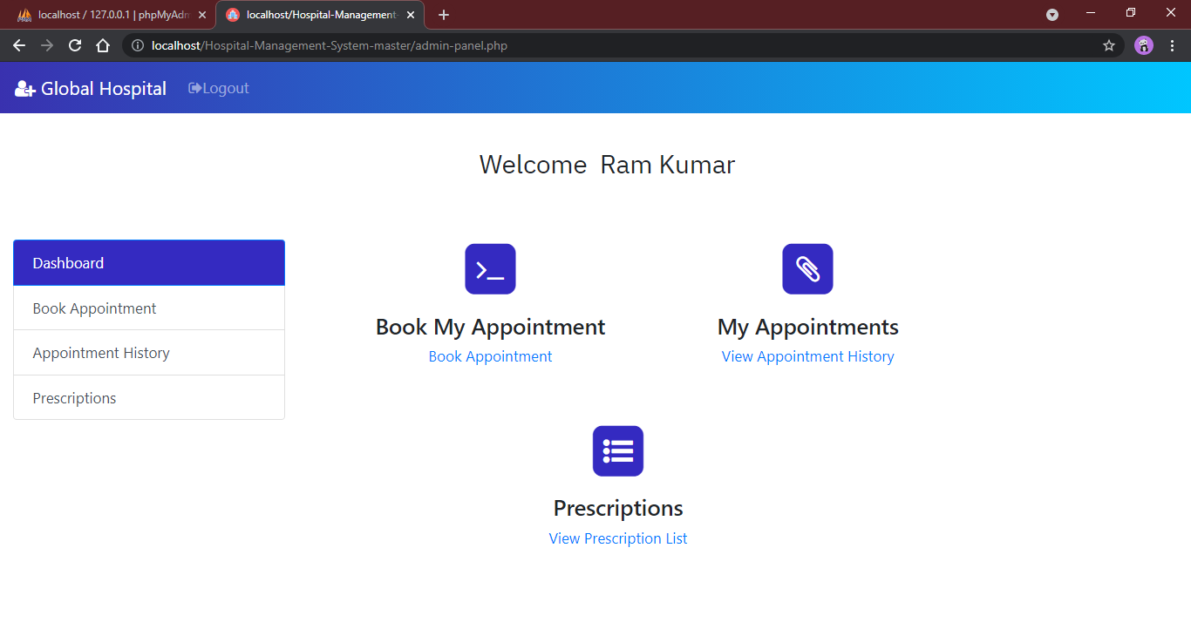
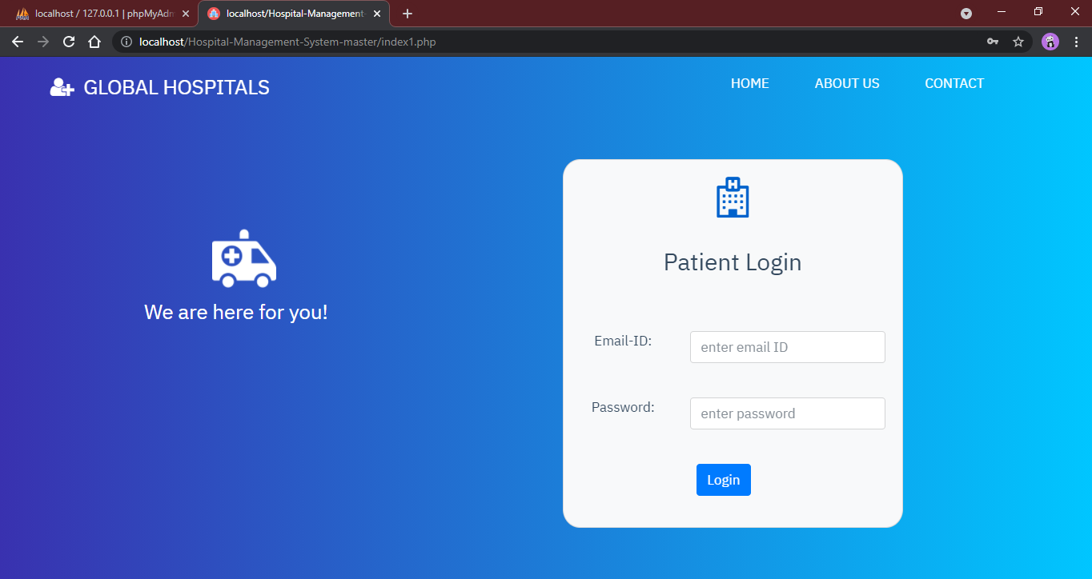
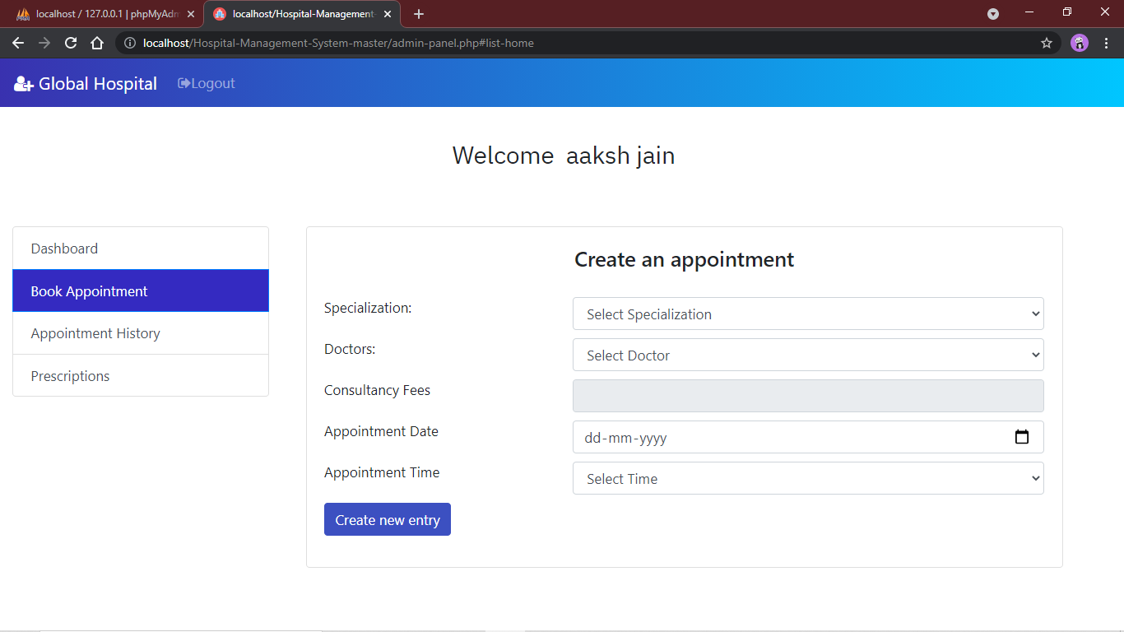
Patient module

Slide 26
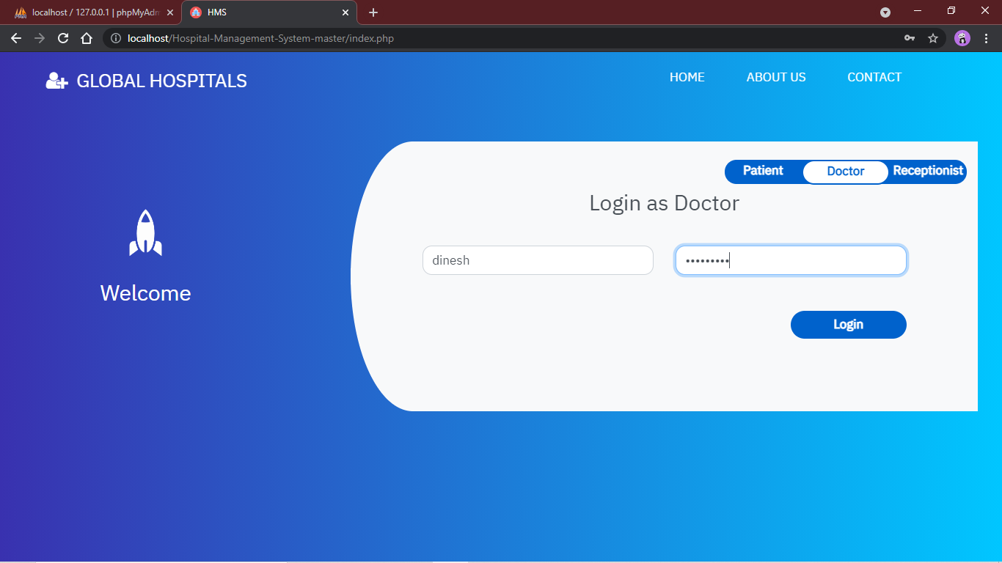
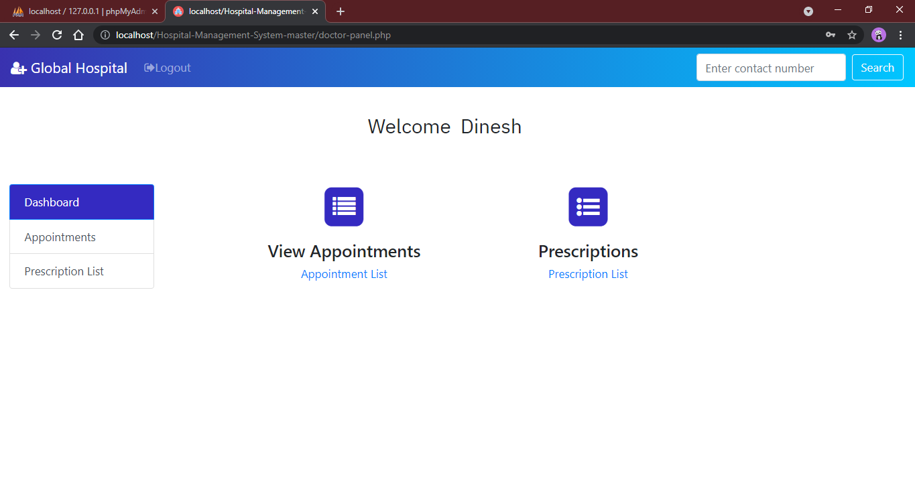
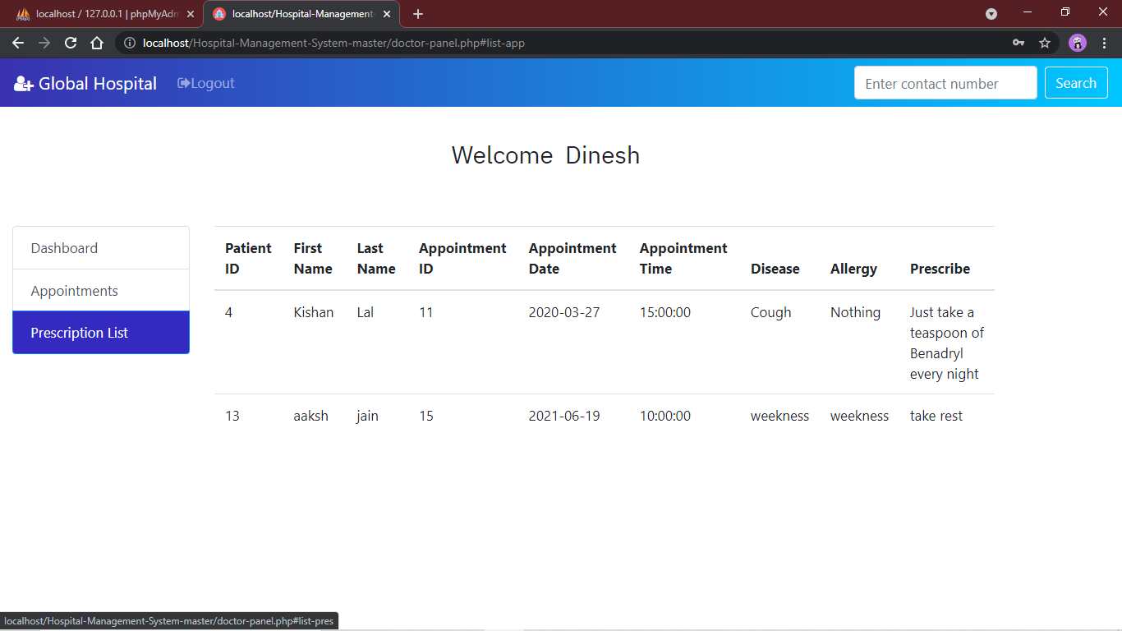
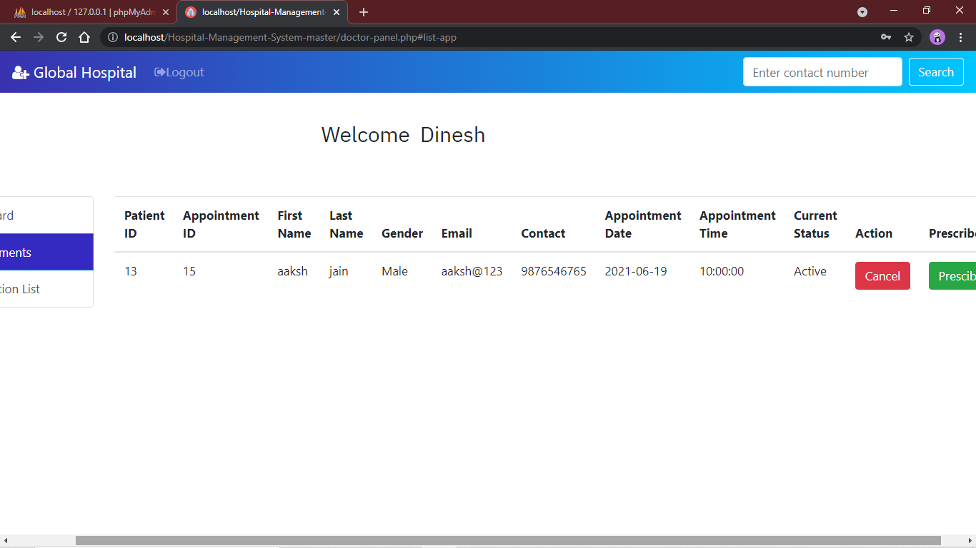
Doctor module
Doctor dashboard

Slide 27
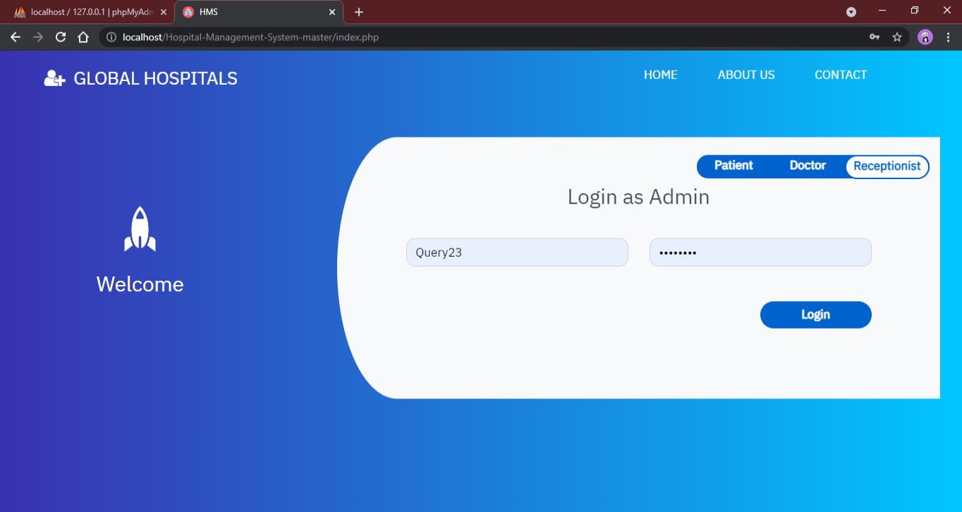
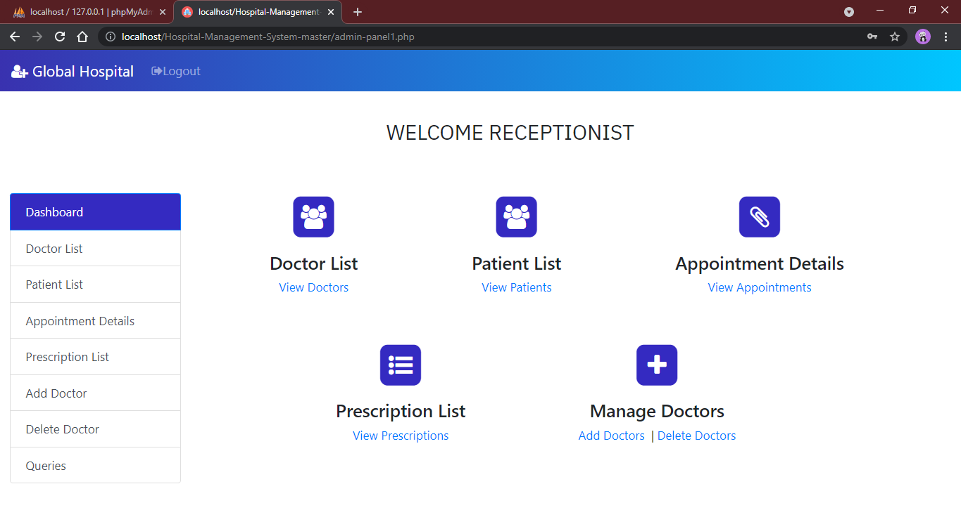
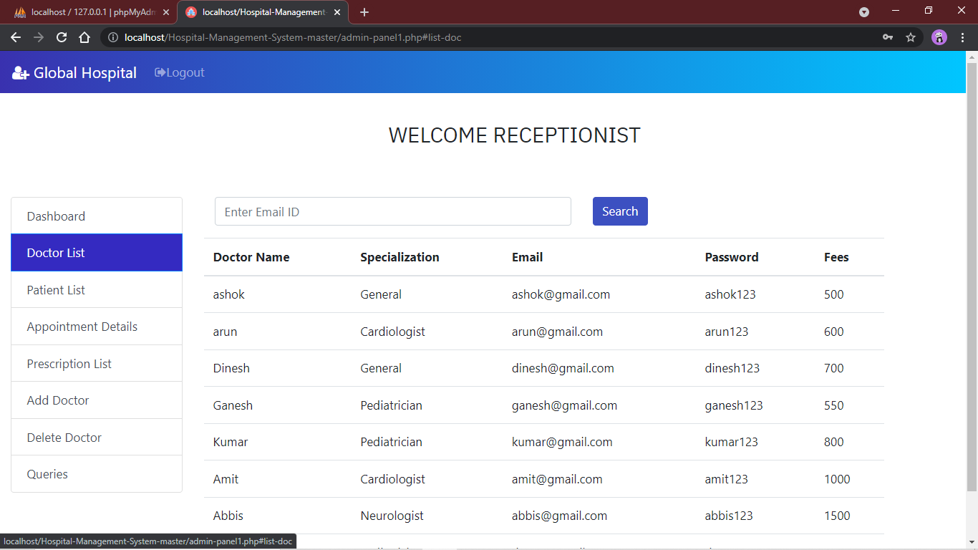
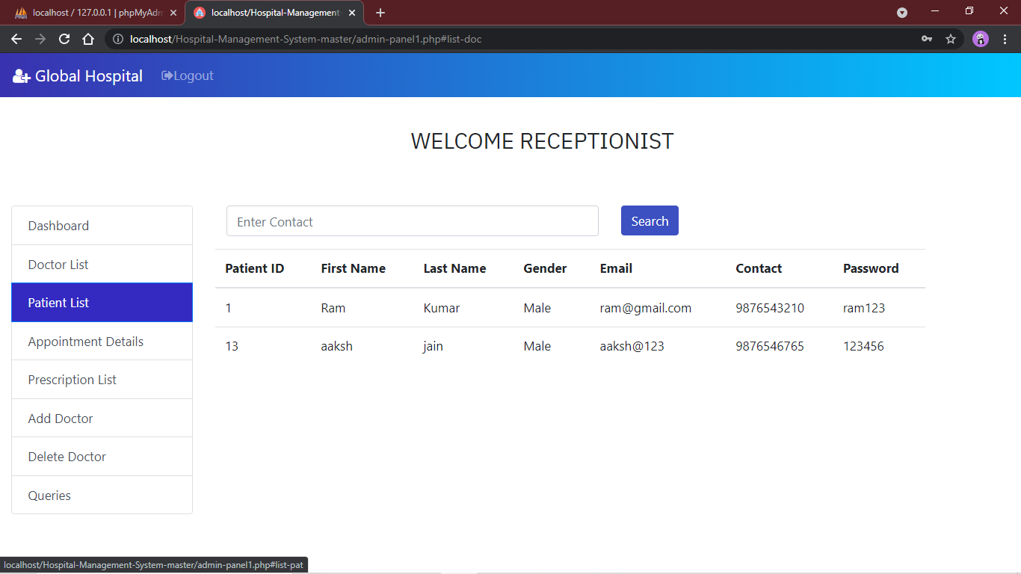
Receptionist module

Slide 28
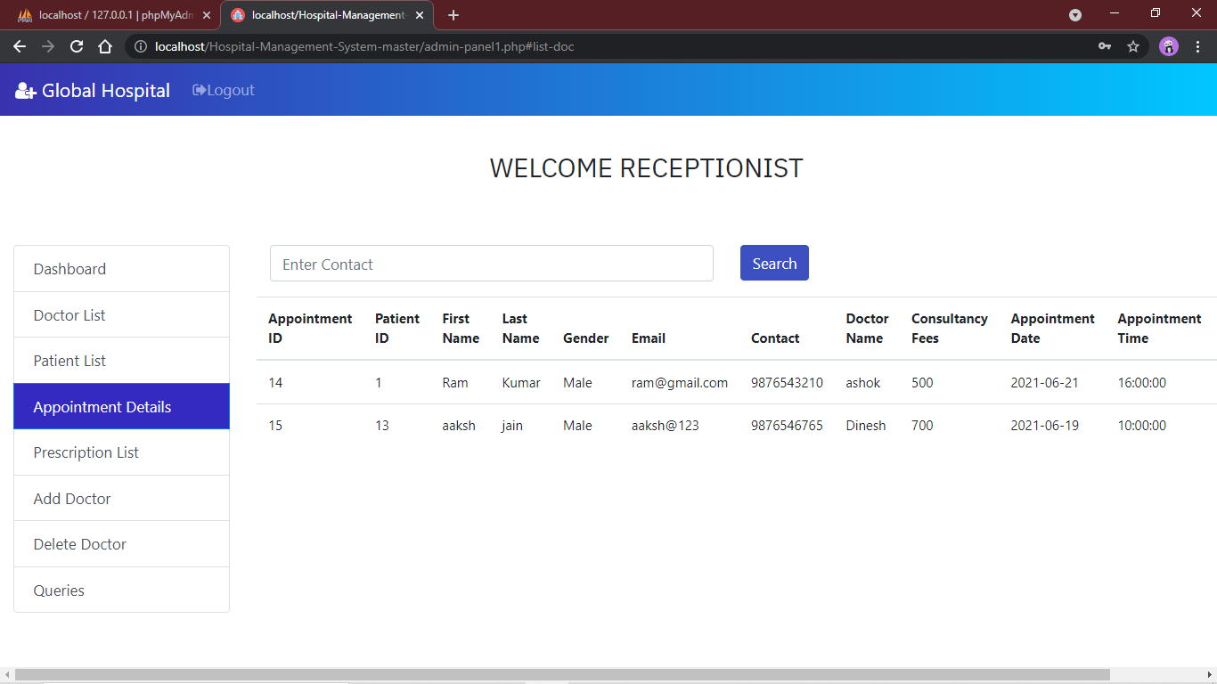
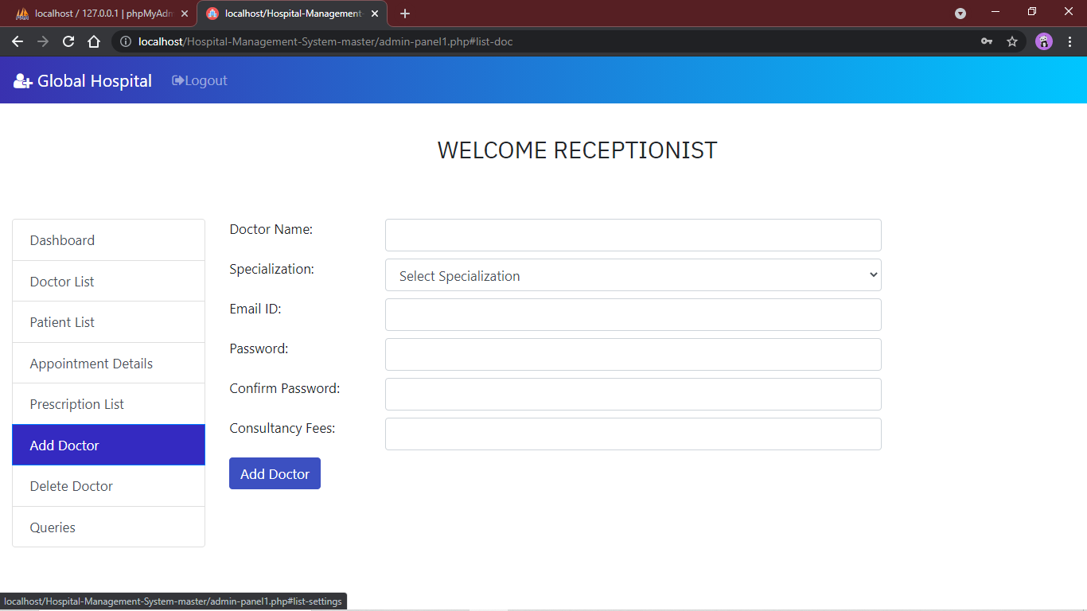
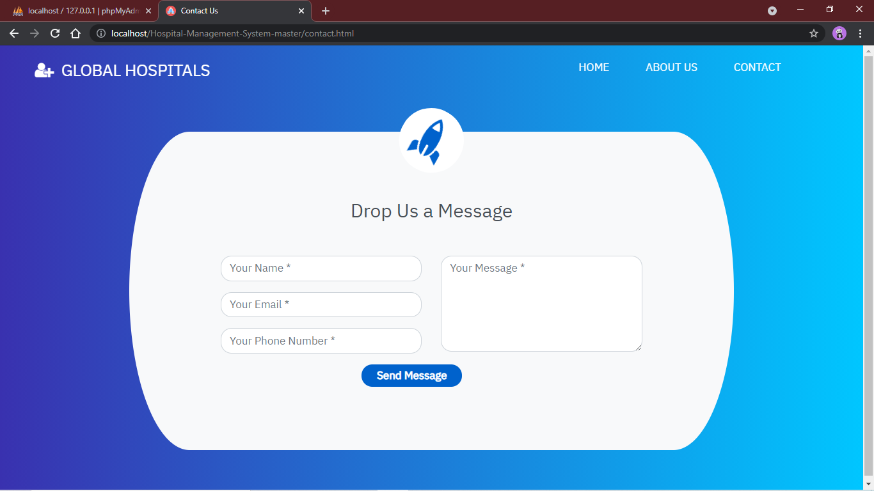
Contact page

Slide 29
Future Enhancement & limitation
The proposed system is Doctor Appointment System. We can enhance this system by including more facilities like pharmacy system for the stock details of medicines in the pharmacy. Providing such features enable the users to include more comments into the system.
Limitation
The size of the database increases day-by-day, increasing the load on the database back up and data maintenance activity.
Training for simple computer operations is necessary for the users working on the system
.

Slide 30



Conclusion
The Doctor Appointment System is for computerizing the working in a hospital. The software takes care of all the requirements of an average hospital and is capable to provide easy and effective storage of information related to patients that come up to the hospital

